Slide 1








INTRODUCTION TO
GIT & GITHUB
Presented by: Pratyush Jain IT-68
Prince Rajput IT-69
Raj Nagar IT-70
Guided by:
Dr. Lalit Purohit Sir and Mr. Upendra Singh Sir

Slide 2






Overview
What is Version Control System ? About Git & GitHub
Difference between Git & GitHub Setting up Git
Configure Git
Account Creation of GitHub Branching, Forking , Merging Basic commands of Git Upload Project on GitHub

Slide 3


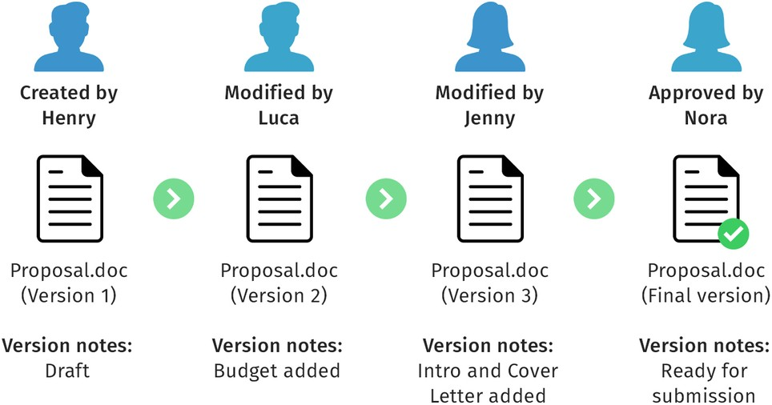


What is Version Control System ?
1. It tracks changes to files and code. 2. Facilitates efficient collaboration for multiple users. 3. Records modifications and maintains a change history. 4. Enables branching and merging for separate development paths. 5. Allows reverting to previous project versions. 6. Ensures structured development and reliable project history.

Slide 4


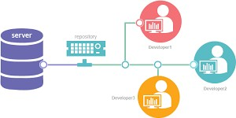


Git: 1. Git: Tracks changes in computer files. 2. Coordinates work among multiple users. 3. Distributed version control system. 4. Allows simultaneous collaboration on files. 5. Widely used in software development for code collaboration.

Slide 5




Characteristics of Git:
Distributed Version Control :
Git is a distributed version control system, allowing multiple users to work on a project simultaneously.
Snapshot-based:
Git records the entire project at different points in time as snapshots, making it efficient and providing a complete version history.
Branching and Merging:
Git enables easy branching to work on different features or changes independently and allows seamless merging of branches.
Local Operations:
Most Git operations are performed locally, making it fast and efficient, without requiring a constant connection to a central server.

Slide 6

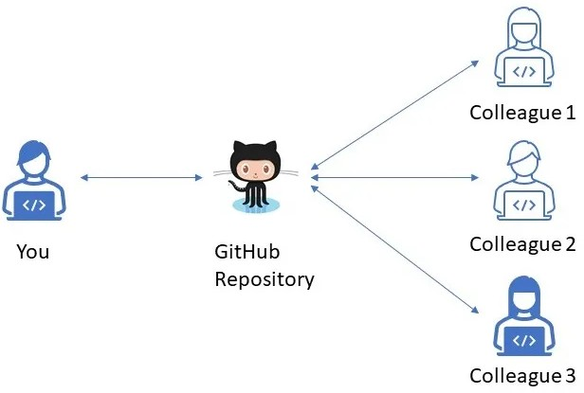

GitHub:
1. GitHub is a web-based platform for collaborative development using Git.
2. It serves as a centralized location for storing, managing, and sharing code.
3. Users create repositories to host projects and track changes through Git version control.
4. Collaboration is facilitated, allowing multiple contributors to work on the same codebase.
5. GitHub provides features like issue tracking, pull requests, and discussions.
6. It is widely used for team-based software development and open-source projects.

Slide 7

Difference
Git
Distributed version control system. Operates on a developer's machine. Manages code versions locally.
No internet dependency. No collaboration features Command-line tool.
GitHub
Web-based platform.
Hosts repositories in the cloud. Provides project management features. Requires internet access for usage.
Facilitates remote collaboration. Provides a graphical interface.

Slide 8




Creating account on GitHub:
1. Open your web browser and go to the GitHub website at https://github.com.

Slide 9

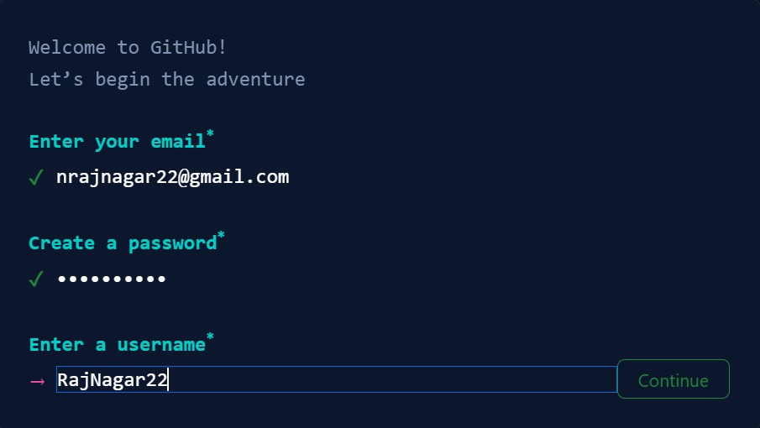



2. On the GitHub homepage, you'll see a "Sign up" form. Enter your desired email address and password.

Slide 10

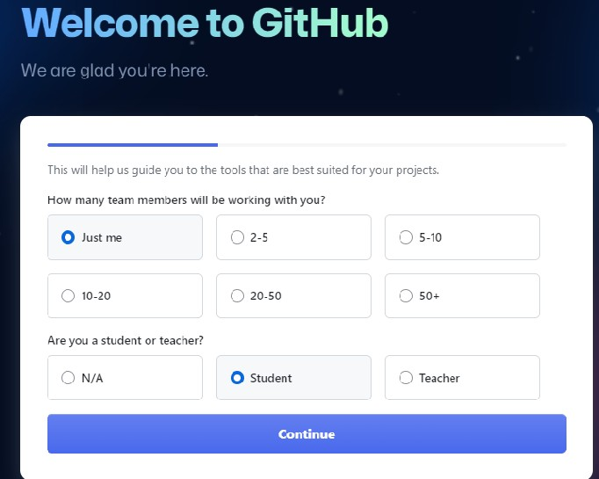


GitHub will send a verification email to the email address you provided. Go to your email inbox, open the email from GitHub, and follow the instructions to verify your email.
You'll be prompted to complete the sign-up process. Optionally, you can:
Customize your experience by selecting your interests. Choose to receive updates and newsletters from GitHub.
5. Acount creation is completed, personalize your account as per your needs.

Slide 11

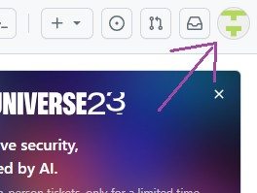
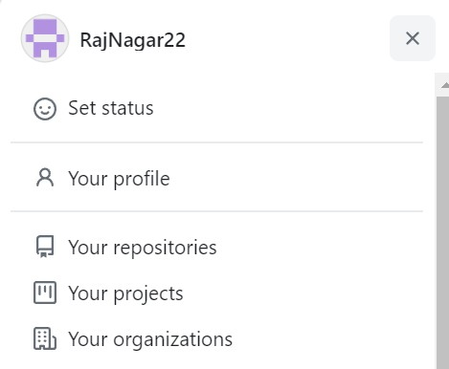



Creating New Repository in GitHub:
Login to your GitHub and Click on the top right corner icon.
From the appeared dropdown list select “Your Repositories".
3. Now select “New” button

Slide 12


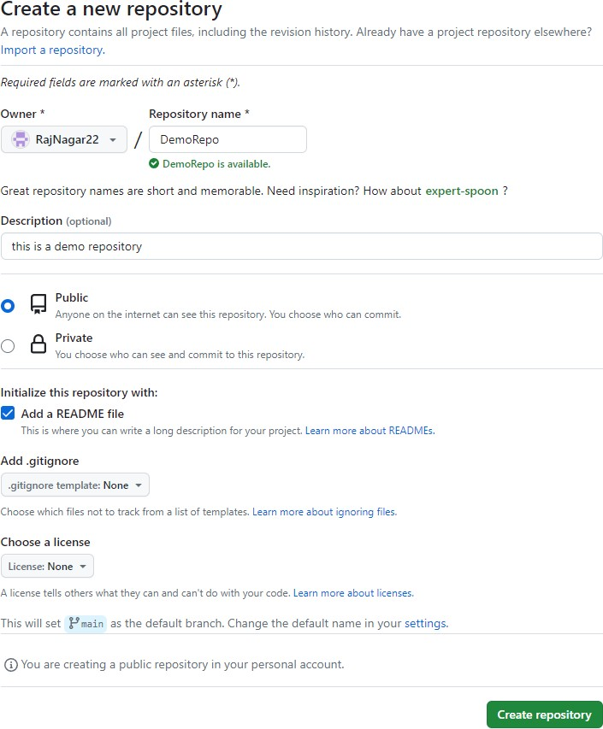
4. A new form will appear, type all the required details of the new repository in the form and click on “Create Repository” Button. Then the new repository will be created on GitHub.

Slide 13
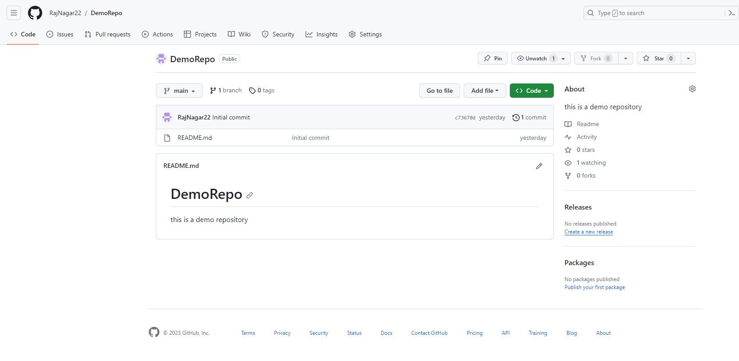
5. Newly created Repository will appear like this :

Slide 14
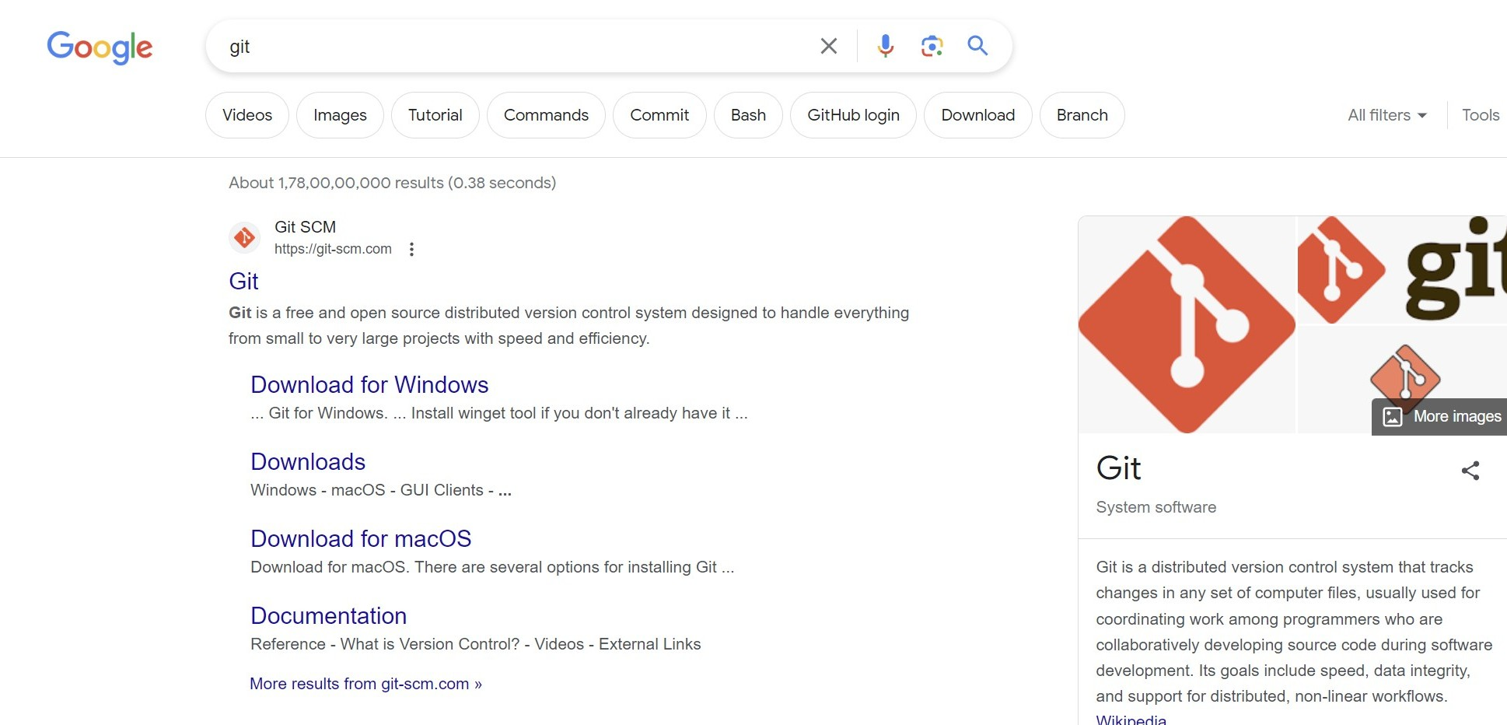

Setting Up Git:
1. Type git in your web browser’s search bar.

Slide 15


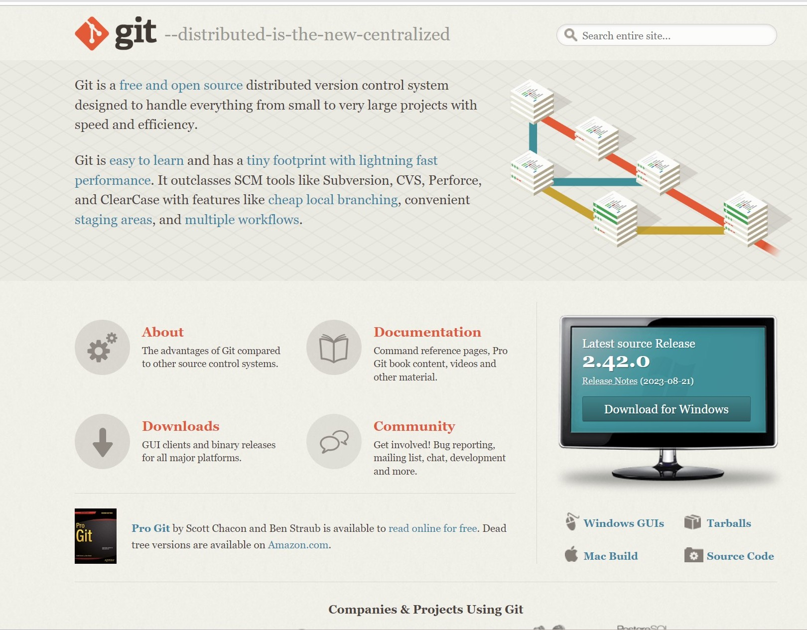
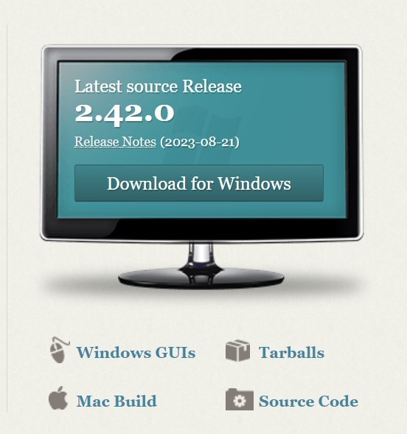

2. If you’re a windows user click download for windows, else click on mac build.

Slide 16
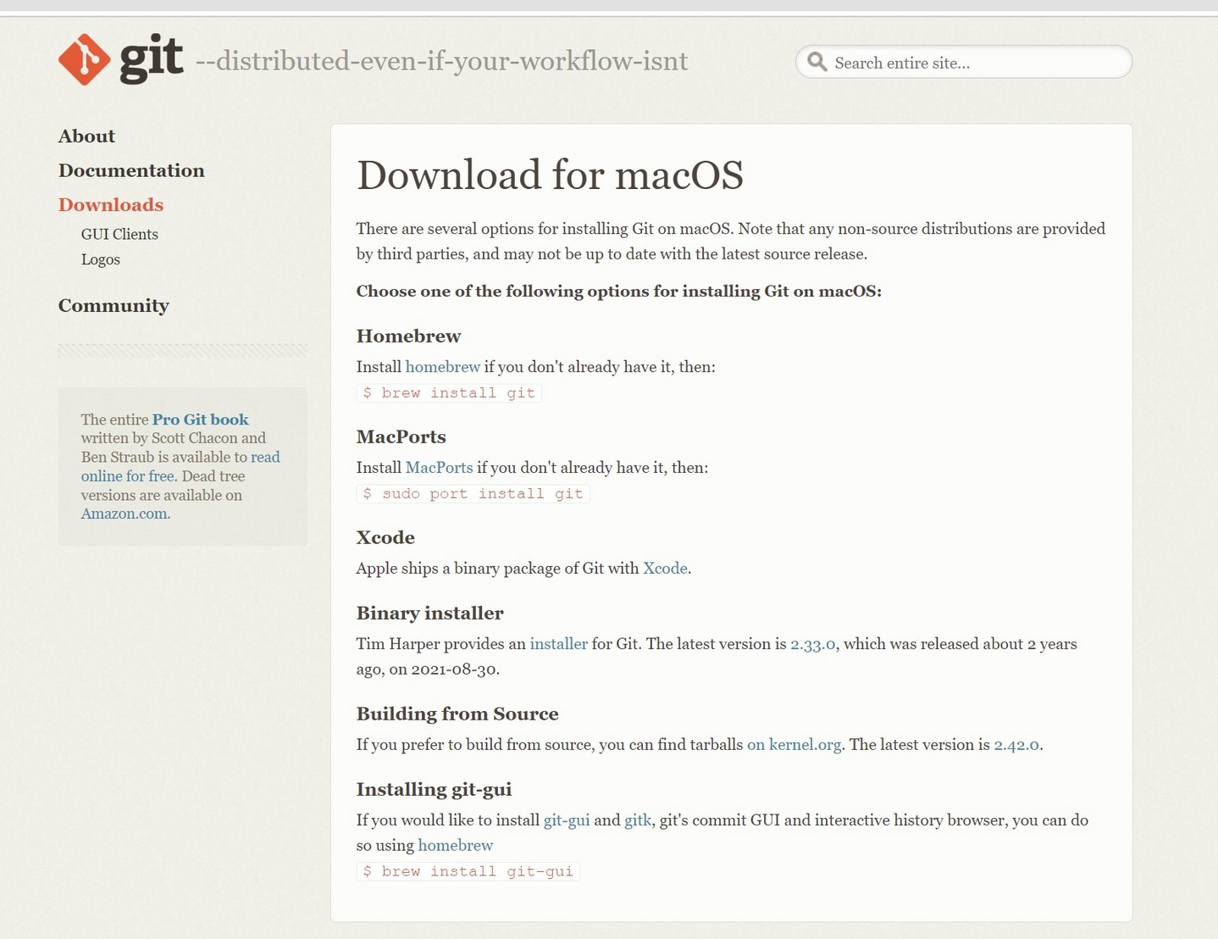
3. Mac users should follow the given procedure:

Slide 17
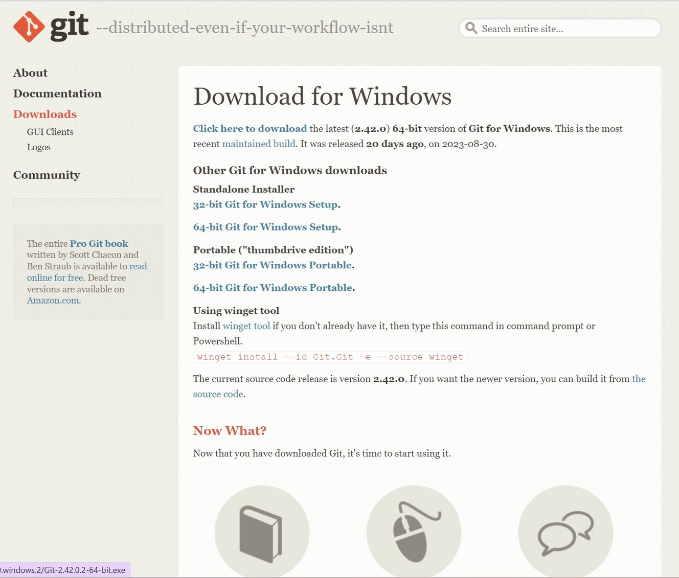

4. Click on click here to download.

Slide 18
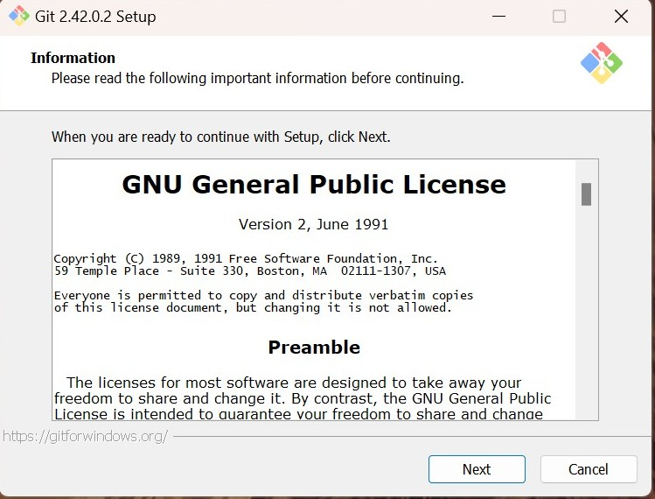

5. After the download is complete, open the downloaded file and the following setup dialog box will appear.

Slide 19


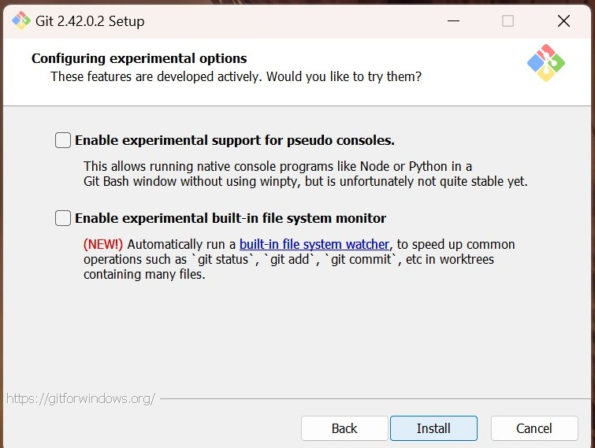
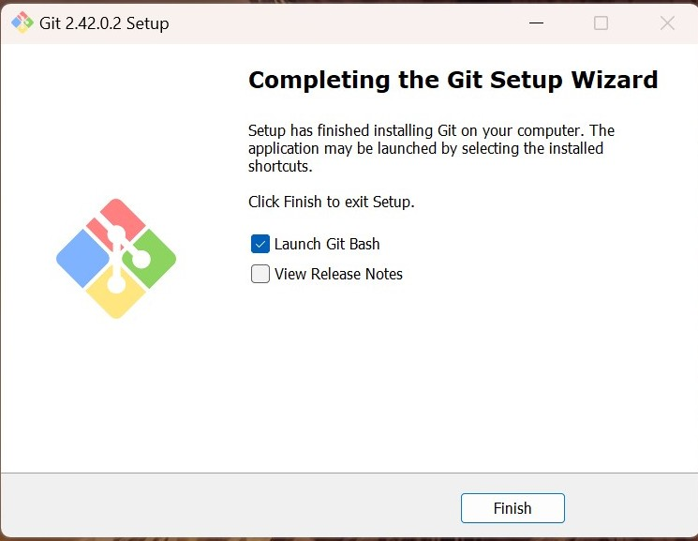
6. Keep clicking “next” until the following dialog box appears. Now click ”install” and git would be installed. Clicking finish would launch Git Bash.

Slide 20
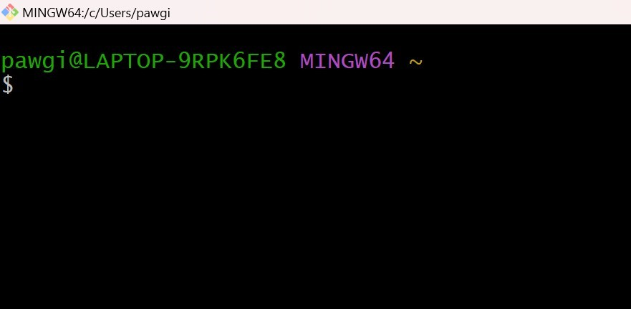





7. This is how the git bash looks like.

Slide 21




What is Git Bash and why are we using ?
Git Bash is a Windows application that emulates a Linux-like command line interface, enabling Git usage. It installs Bash, common utilities, and Git, providing a familiar environment for Windows users to work with Git as it resembles Linux and macOS terminal experiences.

Slide 22
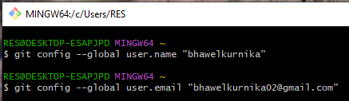



Configure Git:
git config command is used for configuring our username and email address. So for configuration, we can type the following command:

Slide 23
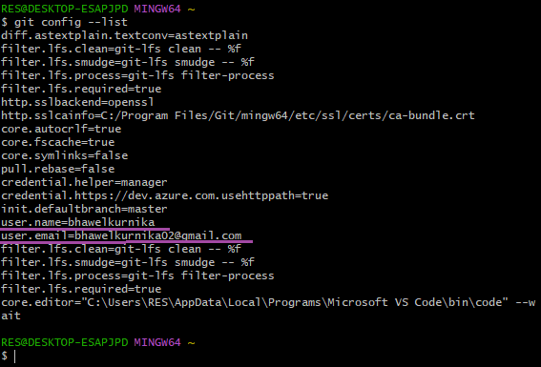

Configure Git:
git config --list Command. (To verify configured username and email)

Slide 24



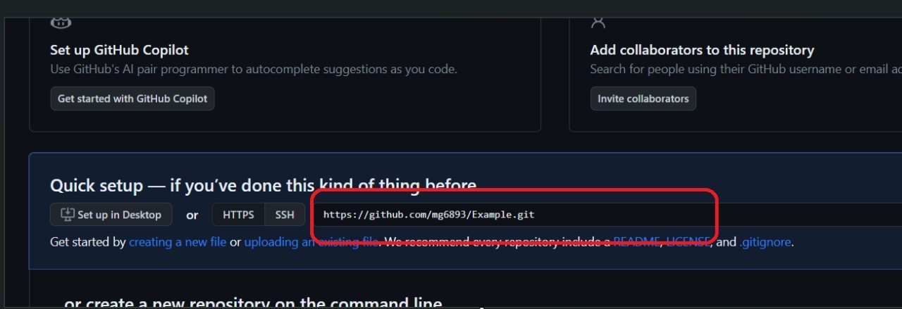

Basic Commands: Clone
"Clone" in GitHub means making a copy of a repository from the remote server to your local computer for editing.
syntax: git clone <link>

Slide 25
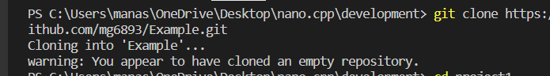


Slide 26
Git Status
“git status” is a Git command that displays the current state of your local Git repository, showing which files have been modified, added, or deleted, and their status in relation to the last commit. It helps you track changes before committing them.
syntax: git status

Slide 27
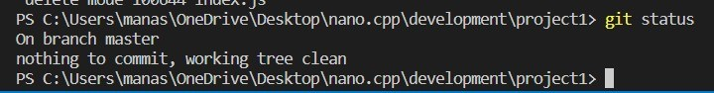
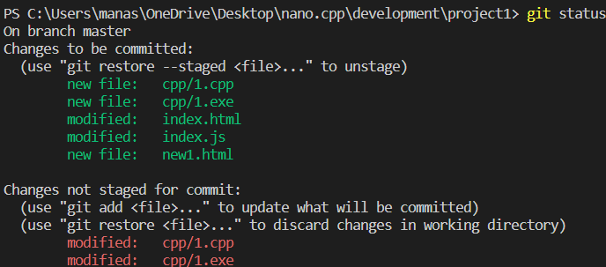
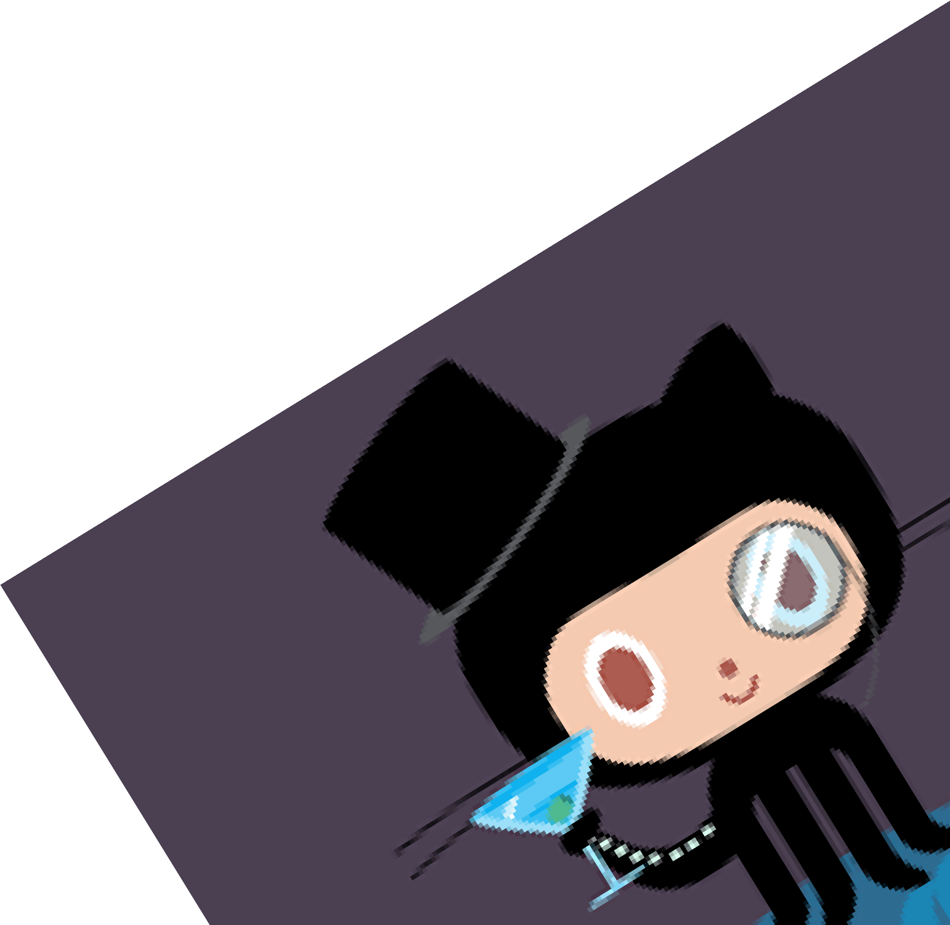


Slide 28

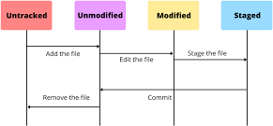
Status of a file/Repo:
“Untracked”: New files that git doesn't yet track. “Modified”: Changed/Changes made in file. “Staged”: Files ready to be committed. “Unmodified”: Unchanged.

Slide 29


How Git Tracks:
add: Adds new or changed files in our working directory to git staging areas.
syntax: git add <file name>
git add . -> to add all the files to staging area.
commit: It records changes after add commands. syntax : git commit -m “ message “

Slide 30




Push:
Used to upload repo content to remote (on github ).
The "push" command in Git, commonly used with platforms like GitHub, is the process of uploading your local code changes to a remote repository. It synchronizes your local commits with the remote repository, allowing collaboration and sharing of code changes with others working on the same project.
syntax: git push origin main.

Slide 31
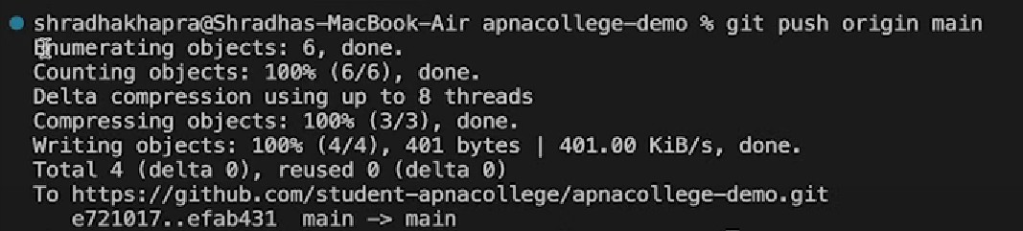


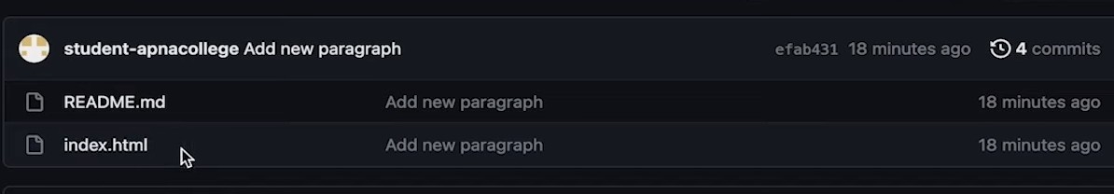


Slide 32


What we have done till now: Created a new repository on github Cloned it to VS Code
Made changes in repo and then added and committed. Again pushed back that repo to github.

Slide 33
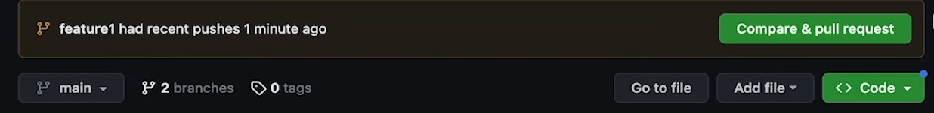

Pull request:
A "pull request" (PR) is a feature on platforms like GitHub where you propose code changes to a repository. Others review, discuss, and potentially merge your changes into the main codebase. It facilitates collaboration and quality control.
syntax: git pull origin main

Slide 34
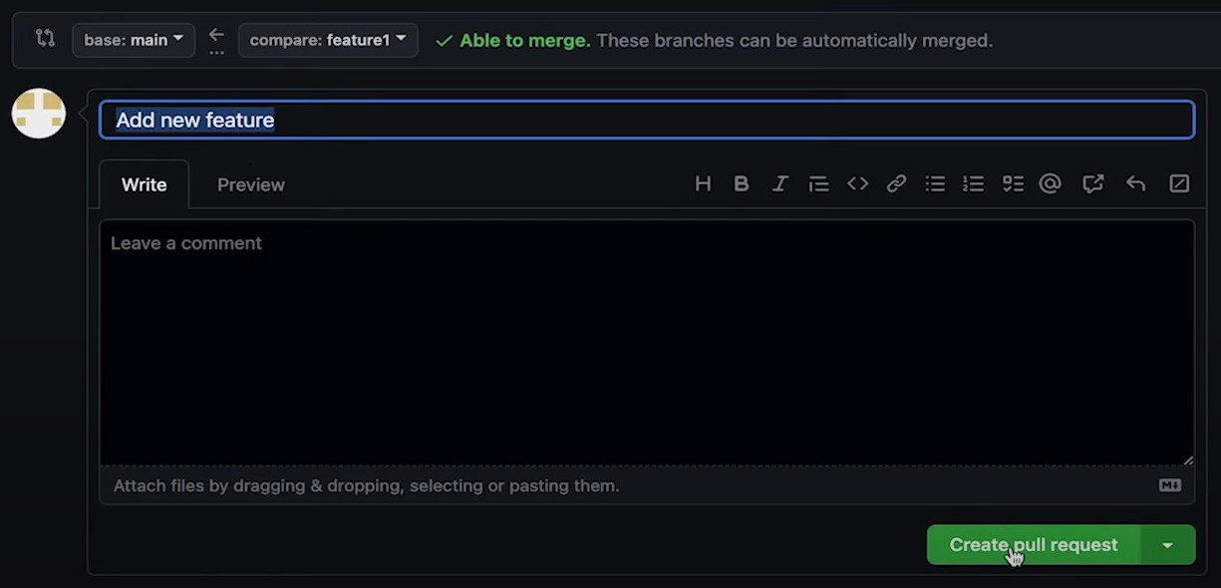

Slide 35
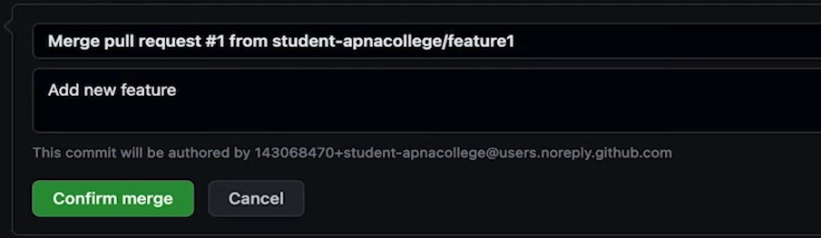
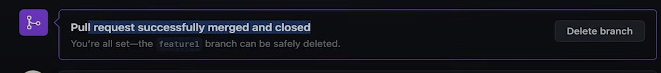

Slide 36
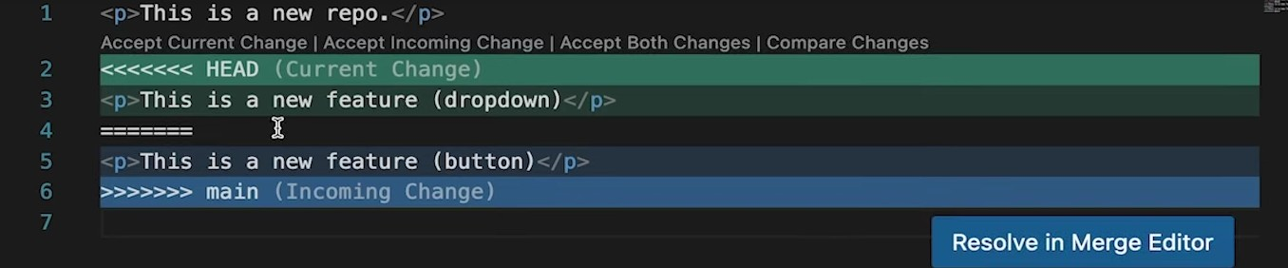
Resolving Merge conflicts:
An event that takes place when git is unable to automatically resolve differences in code between two commits.
syntax: git merge <file_name>

Slide 37


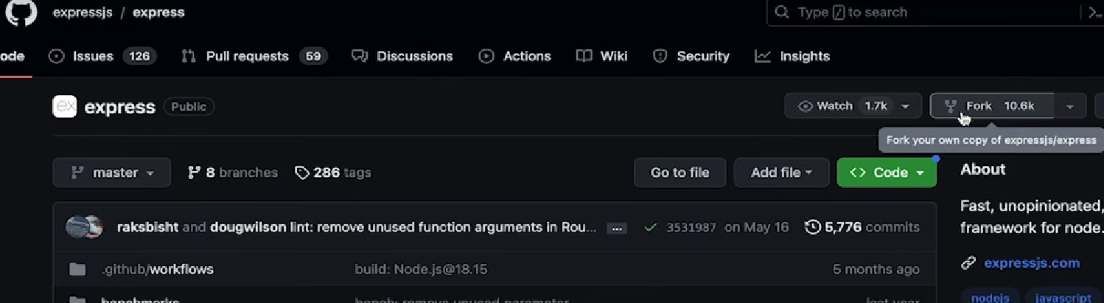

Fork:
The "fork" command in Git, typically used in platforms like GitHub, creates a personal copy of a repository, allowing you to make independent changes without affecting the original project.
Fork is like a rough copy

Slide 38
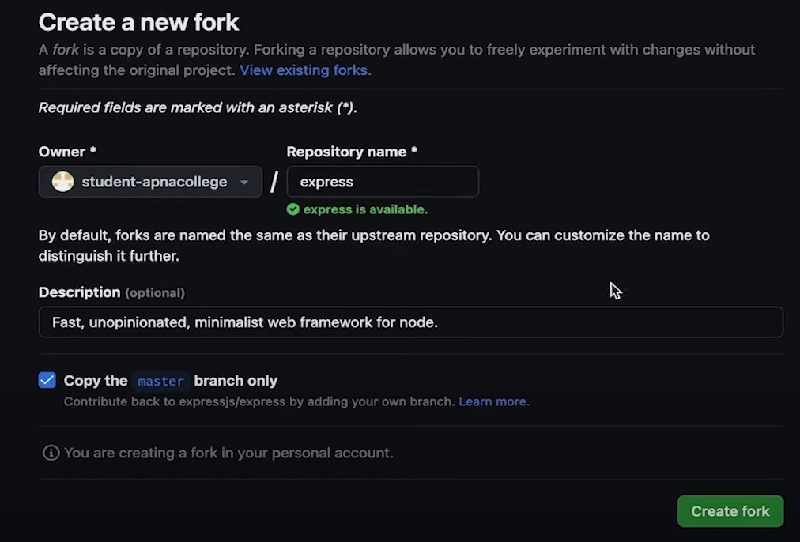

Slide 39






THANK YOU!

